Slide 1
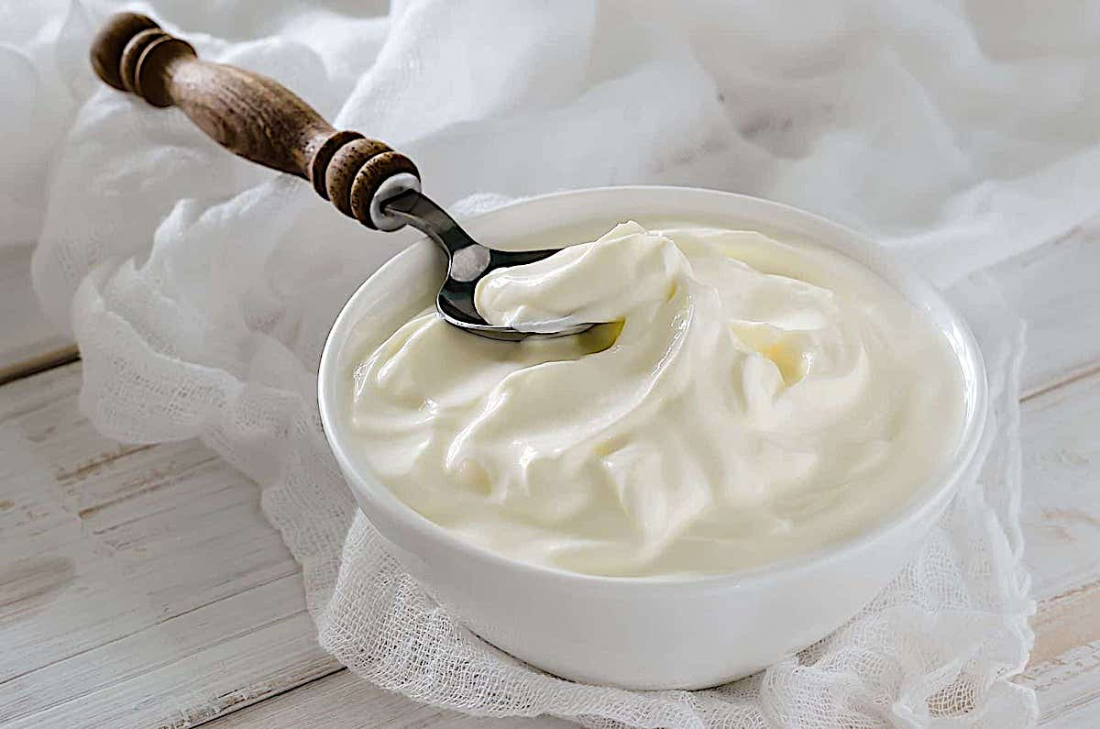
webinar
Yogurt: Understanding Growth Opportunities
February 2023
Source: Innova Market Insights
Notes:
This webinar covers spoonable yogurt, drinking yogurt and fermented yogurt drinks: plain and flavored, mainly dairy but also non-dairy trends.
The consumer research in this webinar comes from several surveys:
the Innova Category Survey 2023, Innova Trends Survey 2021, Innova Lifestyle & Attitudes Survey 2022 and Innova Meat, Dairy & Alternative Proteins Survey 2021.
All were carried out online among consumers aged 18-65, and N = 1,000.

Slide 2
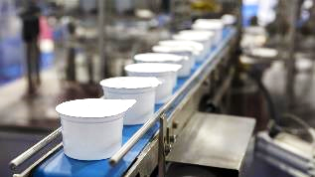
Agenda for today’s webinar
2.
Reasons for purchasing yogurt (health leads).
4.
The Immunity–Gut Health link: consumer perspectives
1.
Per capita growth in yogurt consumption.
3.
Health claims on dairy yogurt vs. plant-based
The consumer research comes from several surveys: the Innova Category Survey 2023, Innova Trends Survey 2021, Innova Lifestyle & Attitudes Survey 2022 and Innova Meat, Dairy & Alternative Proteins Survey 2021.
All were carried out online among consumers aged 18-65, and N = 1,000. (See Methodology for further detail)
5.
Key learnings

Slide 3
category insider
Per capita growth in yogurt consumption

Slide 4
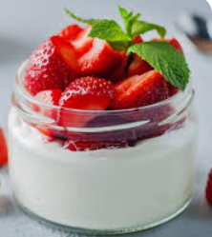
According to the USDA, per capita consumption of yogurt increased 6.7% since 2019
Per Capita Yogurt Consumption
Up 6.7%
Pound Per Person
Source: USDA ERS

Slide 5
category insider
Reasons for purchasing yogurt: Health tops the list

Slide 6
1 in 5 US consumers increasing consumption of yogurt
Figure 2 |
US yogurt: Have you increased or decreased your consumption of yogurt/drinkable yogurt over the past year? (Average: 36 countries vs North America) (2023)
Consumption habits in the US mirror the global picture, with the majority of consumers in the US maintaining consumption of yogurt, and 1 in 5 increasing consumption. In Canada, the number of consumers increasing consumption is lower, with more consumers saying they are maintaining consumption rates.
Source: Innova Category Survey 2023

Slide 7
Health and taste drive consumption of yogurt in US
Figure 3 |
US yogurt: Why do you consume yogurt/drinkable yogurt? (Average: 36 countries vs US) (2023)
US
% respondents
49%
45%
29%
19%
17%
16%
12%
17%
13%
12%
Source: Innova Category Survey 2023
Notes:
Health and taste drives consumption of yogurt in the US. The majority of Americans maintaining consumption, but 1 in 5 are increasing consumption.

Slide 8
Flavor and cost influence purchasing behavior among US consumers
Figure 4 |
US yogurt: Which product attributes most influence your purchasing decision when consuming yogurt/drinkable yogurt? (Average: 36 countries vs US) (2023)
Flavor
Cost
Freshness
Health aspects
Brand
Global average
Source: Innova Category Survey 2023

Slide 9
Natural and protein claims important to US consumers when buying yogurt
Figure 5 |
US yogurt: Which claims most influence your purchasing decision when consuming yogurt/drinkable yogurt? (Average: 36 countries vs US) (2023)
US
% respondents
28%
12%
20%
22%
20%
18%
12%
12%
9%
12%
12%
12%
Source: Innova Category Survey 2023

Slide 10
US: daytime consumption of yogurt
Figure 7 |
US yogurt: When do you typically consume yogurt/drinkable yogurt? Select up to three (Most popular meal occasions vs global average) (2023)
US: Preferred consumption occasions
Global average
Source: Innova Category Survey 2023

Slide 11
Plant-based diets remain niche in US
Figure 8 |
US yogurt: Diet principles by market (2021)
Source: Innova Meat, Dairy & Alternative Proteins Survey 2021
Notes:
Plant-based diets remain niche: the US has some of the lowest flexitarianism rates in the world, but 1 in 4 regularly consume meat and dairy alternatives.

Slide 12
A closer look at the dairy alternatives consumer in the US…
Figure 9 |
Global yogurt: To what extent do you agree or disagree with the following statement? “I regularly eat plant-based foods as an alternative to meat and/or dairy” (2021)
While only a relatively small proportion of consumers in the US say they are vegan (5%), 1 in 4 consumers say they regularly eat plant-based foods as an alternative to meat or dairy. This may be driven by several reasons, including health and ethical/ environmental reasons.
Source: Innova Meat, Dairy & Alternative Proteins Survey 2021

Slide 13
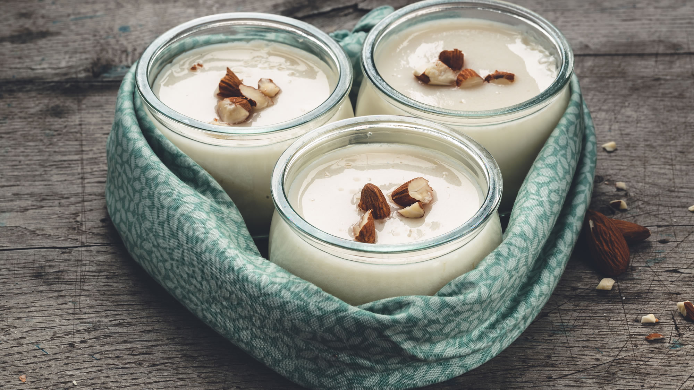
category insider
What’s Shaping the Category?

Slide 14
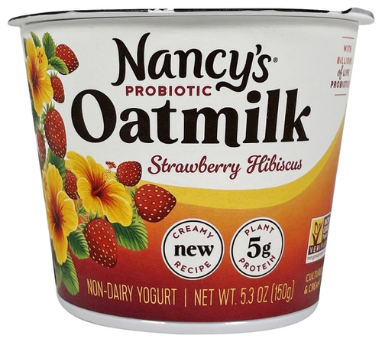
Dairy yogurt still dominates NPD, but non-dairy is taking significant share
Dairy yogurt still accounts for the majority of NPD in the US, but product launch activity has declined significantly over the past five years. Non-dairy is now mainstream and accounts for 1 in 4 product launches
Figure 23 |
US yogurt: Launches by subcategory
(12 months ending Q3 2022)
Nancys Protiobic Oatmilk Non-Dairy Yogurt: Strawberry Hibiscus
Probiotic. Non-dairy. New creamy recipe. Contains 5g plant protein. Non-GMO Project verified. Certified kosher dairy. Separate paper to recycle. Cultured and creamy. With billions of live probiotics. Free of gluten, soy, nuts and dairy. Plant-based.
Oatmilk (water, whole oat flour), organic cane sugar, coconut oil, chickpea protein, strawberry puree concentrate, tapioca flour, organic inulin, organic strawberry natural flavor, natural flavor, gellan gum, fruit and vegetable juice (color), hibiscus natural flavor, concentrate (hibiscus and apple), citric acid, live non-dairy yogurt cultures: s. thermophilus, l. bulgaricus, live non-dairy probiotic cultures: bifidobacterium lactis bb-12, l. acidophilus, l. rhamnosus lgg. United States, Sept 2022
Source: Innova Market Insights
Notes:
The majority of NPD is dairy yogurt, but 1 in 4 launches are now non-dairy yogurt. Both categories have seen a fall in NPD.

Slide 15
US DAIRY yogurt: top health claims vs. same claims NON-DAIRY yogurt: % total launches 2018-2022
Top claims: Spoonable DAIRY Yogurt | Spoonable DAIRY Yogurt: % Subcategory launches 2018-2022 | Spoonable NON-DAIRY Yogurt: % Subcategory launches 2018-2022
Ethical - Packaging | 63.2% | 41.8%
Low/No/Reduced Fat | 61.4% | 0.5%
Gluten Free | 57.1% | 70.4%
High/Source of Protein | 49.7% | 27.0%
GMO Free | 29.1% | 59.4%
No Additives/Preservatives | 28.6% | 30.5%
Natural | 24.4% | 4.5%
Probiotic | 21.6% | 43.7%
Digestive/Gut Health | 21.4% | 31.9%
Organic | 13.9% | 20.0%
Vitamin/Mineral Fortified | 10.5% | 0.9%
HFCS Free | 8.8% | 0.9%
No Added Sugar | 6.7% | 16.4%
Reduced Sugar | 5.6% | 3.5%
Immune Health | 3.1% | 5.2%
Notes:
Almost all of the key health claims made in yogurt globally are over-indexed in US yogurt NPD.
The only exception is No Added Sugar; sugar clai,s are significantly under-represented in the US; unlike in other markets, US companies are more likely to be focusing on fat reduction than sugar reduction.
Protein intake continues to be a key trend in the US, and yogurt has consistently been a key category for high protein products to be marketed. This has driven interest and demand in Greek yogurt and more recently Icelandic skyr yogurt, both of which have naturally higher levels of protein than standard yogurts.
One reason that alternative dairy is gaining ground at a time when Yogurt growth has been dampened a bit by inflation could be the benefits/claims that it capitalizes on. eg Immunity, Digestive-Gut health

Slide 16
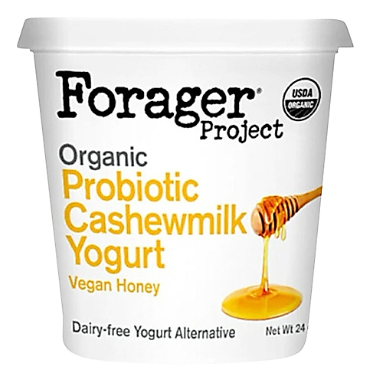
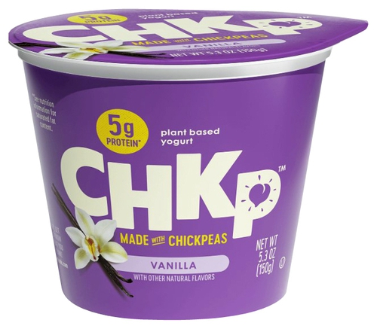
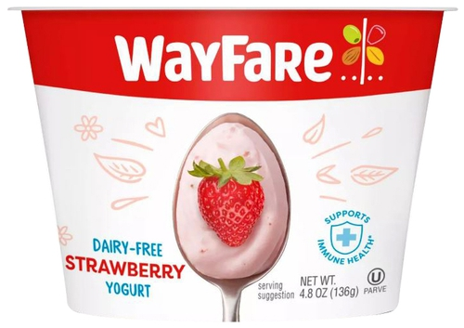
Non-Dairy yogurt claims: Probiotic, Gut health, Immune Health
Forager Project Organic Probiotic Cashewmilk Yogurt: Vegan Honey
United States, Feb 2023 | VIEW DETAILS
Claims: USDA organic. Probiotic. Suitable for vegans. Dairy free.
Wayfare Dairy-Free Strawberry Yogurt
United States, Feb 2023 | VIEW DETAILS
Claims: Contains 3g of fiber and 5g of protein. 15% RDV vitamin D. Contains prebiotics and probiotics. Suitable for vegans. Gluten free. Soy free. Dairy free. Non-GMO. Certified kosher parve. Supports immune health.
Chkp Plant Based Yogurt Made with Chickpeas: Vanilla
United States, May 2022 | VIEW DETAILS
Claims: Contains 9 essential amino acids. Super sustainable: need very little water to grow, support healthy soil. Contain all nine essential amino acids …Low carbon footprint. Contains 5g protein. Certified kosher. No dairy, and Probiotic, to promote a healthy gut and happy body. Proudly GMO free, gluten free, and soy free. Suitable for vegans
Source: Innova Database

Slide 17
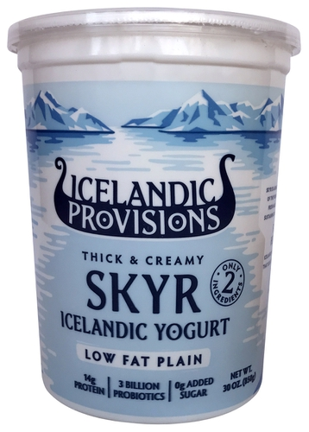
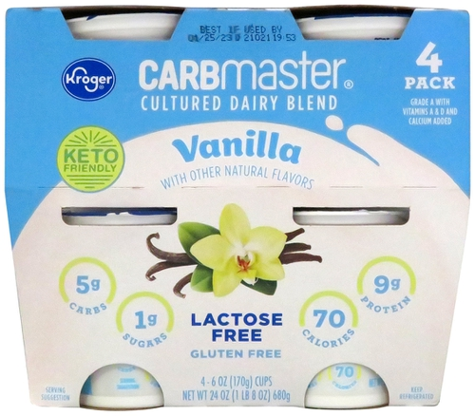
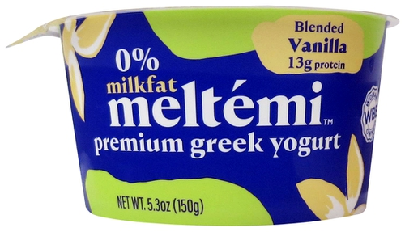
Protein claims: present in 50% dairy yogurt NPLs
Icelandic Provisions Low Fat Plain Skyr Icelandic Yogurt
United States, Jan 2023 | VIEW DETAILS
Claims: Only 2 ingredients. Low fat. Contains 14g protein. Contains 3 billion probiotics, live and active 0g added sugar. A pure nordic experience with delicious flavor and texture, made the simplest way. Certified kosher dairy. Grade A. No artificial flavorings. No artificial sweeteners. No preservatives. No RBST. Gluten free. Certified Icelandic heirloom cultures. Rich in protein, sustaining provision, yogurt dating back to the age of the vikings. Recyclable packaging.
Meltemi Vanilla Blended Premium Greek Yogurt
United States, Jan 2023 | VIEW DETAILS
Claims: 0% milk fat content. Premium. Contains 13g protein. Made only with natural and non-GMO ingredients. Naturally gluten free. Certified kosher dairy. Grade A. Made with yogurt cultures from Greece. Recyclable packaging. Woman owned.
Kroger Carb Master Cultured Dairy Blend: Vanilla
United States, Jan 2023 | VIEW DETAILS
Claims: Grade A with vitamins A and D, and calcium added. With other natural flavors. Keto friendly. Contains 5g carbs, 1g sugars, 70 calories and 9g protein. Lactose free. Gluten free. Please recycle. Guaranteed product. Contains probiotics and other active cultures.
Source: Innova Database

Slide 18
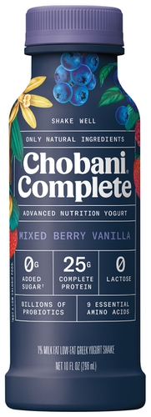
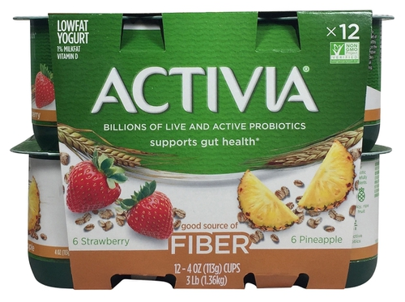
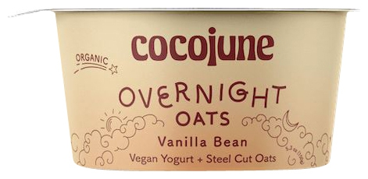
Fiber claims: most frequent in fermented yogurt drinks
Chobani Complete Advanced Nutrition Yogurt Shake: Mixed Berry Vanilla
United States, Nov 2022 | VIEW DETAILS
Claims: Made only with natural ingredients. Advanced nutrition yogurt. 0g added sugar. Contains 25g complete protein. 0 lactose. Contains billions of probiotics. Contains 9 essential amino acids. Low fat with 1% milk fat content. With real vanilla and real berries. Lactose free and easy to digest dairy shake. Contains 3g fiber. … Billions of probiotics to support digestive and immune health. Good source of fiber.
Cocojune Overnight Oats Vegan Yogurt Plus Steel Cut Oats: Vanilla Bean
United States, Jan 2022 | VIEW DETAILS
Claims: Organic. Suitable for vegans. Fiber-filled and probiotic packed.
Activia Low Fat Yogurt: Strawberry and Pineapple
United States, Jan 2020 | VIEW DETAILS
Claims: Low fat with only 1% milk fat content. Source of vitamin D. Non-GMO…Contains billions of live and active probiotics. Supports gut health. Good source of fiber. Probiotic yogurt with carefully selected ingredients. Made with grade A milk and juicy, ripe fruits. May help reduce the frequency of minor digestive discomfort, which includes gas, bloating, abdominal discomfort, and rumbling.
Source: Innova Database
Notes:
Dietary fiber continues to be on-trend, with health-conscious consumers seeking tailored convenience. Not only is fiber intake linked to gut health but it is increasingly associated with general wellbeing as well as improved immunity, and mental health, backed by both science and consumers.
Fiber is of course a natural fit for yogurt with inclusions like fruit.
Fiber claims in 13% Drinking Yog / Fermented beverages, 7% spoonable Non-Dairy Yog, 2% Spoonable dairy yog

Slide 19
Protein claims
Icelandic Provisions Low Fat Plain Skyr Icelandic Yogurt
United States, Jan 2023 | VIEW DETAILS
Description: Thick and creamy low fat plain Skyr Icelandic yogurt in an 850g plastic tub.
Claims: Only 2 ingredients. Low fat. Contains 14g protein. Contains 3 billion probiotics, live and active cultures (heirloom skyr cultures (streptococcus thermophilus islandicus, lactobacillus bulgaricus, bifidobacterium)). 0g added sugar. A pure nordic experience with delicious flavor and texture, made the simplest way. Certified kosher dairy. Grade A. No artificial flavorings. No artificial sweeteners. No preservatives. No RBST. Gluten free. Certified Icelandic heirloom cultures. Rich in protein, sustaining provision, yogurt dating back to the age of the vikings. Recyclable packaging.
Meltemi Vanilla Blended Premium Greek Yogurt
United States, Jan 2023 | VIEW DETAILS
Description: Vanilla blended premium Greek yogurt in a 150g plastic pot.
Claims: 0% milk fat content. Premium. Contains 13g protein. Made only with natural and non-GMO ingredients. Naturally gluten free. Certified kosher dairy. Grade A. Made with yogurt cultures from Greece. Recyclable packaging. Woman owned.
Kroger Carb Master Cultured Dairy Blend: Vanilla
United States, Jan 2023 | VIEW DETAILS
Description: 4 x 170g pots of vanilla flavored cultured dairy blend held within a carton board sleeve.
Claims: Grade A with vitamins A and D, and calcium added. With other natural flavors. Keto friendly. Contains 5g carbs, 1g sugars, 70 calories and 9g protein. Lactose free. Gluten free. Please recycle. Guaranteed product. Contains probiotics and other active cultures.
Source: Innova Database

Slide 20
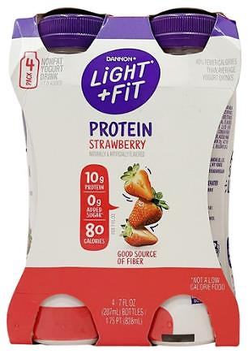
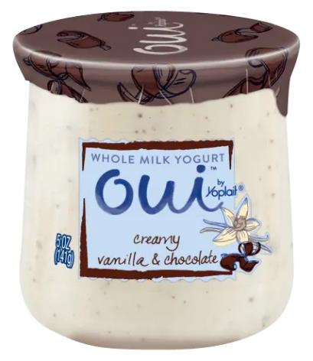
US dairy yogurt flavor trends
Top 10 Flavors
Leading flavor blends

Slide 21
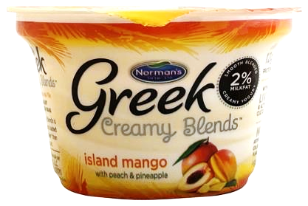
Fruit flavors: always the most popular in US yogurt NPD
Flavor is very important in the US yogurt category, with only 13% of product launches in the 12 months ending Q3 2022 being unflavored.
There has been little change in the top five flavors over the past five years. Similar to the global picture, fruit flavors are some of the most popular flavors. However, as flavor trends change, the popularity of some fruit flavors changes. In the US, banana flavored yogurt has become less popular, while mango entered the top five in 2021-2022.
Figure 29 |
US yogurt: Top 10 flavors (2017-2018 vs 2021-2022)
12 months ending Q4 2018 | 12 months ending Q4 2022
Strawberry | Strawberry
Vanilla | Vanilla
Blueberry | Blueberry
Peach | Peach
Banana | Mango
Normans Greek Creamy Blends Island Mango With Peach And Pineapple Yogurt
Apr 2022
A Greek-style exotic fruit-flavored yogurt with mango, peach and pineapple.
Source: Innova Market Insights
Notes:
Fruit flavors are the most popular flavors, but popularity is changing. Banana has declined while mango has increased

Slide 22
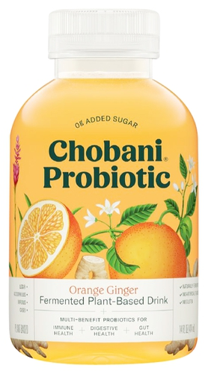
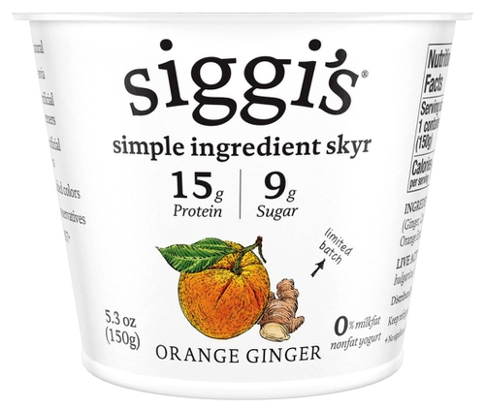
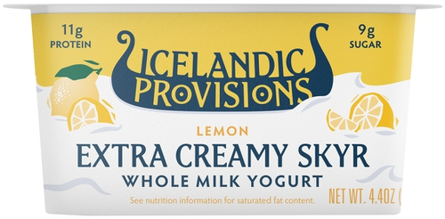
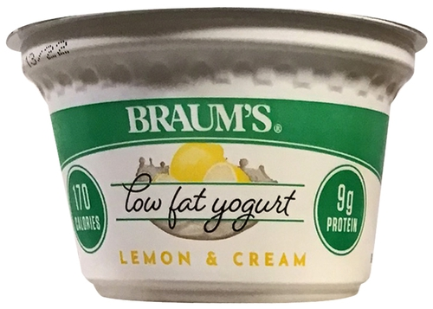
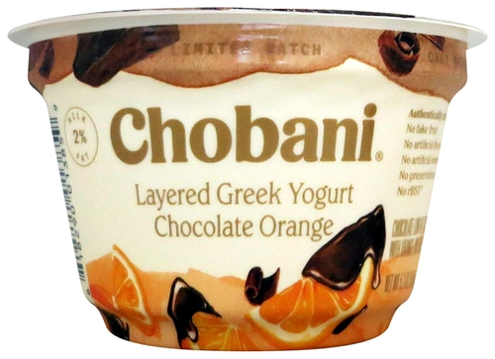
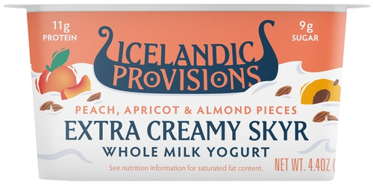
Flavors to watch out for: orange, lemon, almond, ginger
Icelandic Provisions Lemon Extra Creamy Skyr Whole Milk Yogurt
United States, Nov 2022
VIEW DETAILS
Chobani Probiotic Fermented Plant Based Drink: Orange Ginger
United States, Oct 2022
VIEW DETAILS
Siggis Simple Ingredient Skyr: Orange Ginger
United States, Jun 2022
VIEW DETAILS
Braums Lemon & Cream Low Fat Yogurt
United States, Apr 2022
VIEW DETAILS
Chobani Chocolate Orange Layered Greek Yogurt
United States, Apr 2022
VIEW DETAILS
Icelandic Provisions Peach Apricot & Almond Pieces Extra Creamy Skyr Whole Milk Yogurt
United States, Nov 2022
VIEW DETAILS
Source: Innova Database

Slide 23
The Immunity–Gut Health link: consumer perspectives
Notes:
There is growing consumer interest in foods that boost immunity, especially in beverages such as iced tea/kombucha.
We’ll look at these and of course at examples of new yogurt items in this space.

Slide 24
COVID-19: Most consumers globally are becoming more concerned about their health in light of the pandemic
Figure 23 |
Global: In light of COVID-19, how concerned are you regarding your personal health and the health of the people close to you? (Levels of high concern by country) (2021)
Implications for immune health supplements:
Many consumers have found themselves more concerned about their health following the global pandemic, with particularly high levels of extreme concern in Latin America, India, Spain and Indonesia. However, in every country surveyed, more than half of consumers expressed greater levels of concern than prior to the pandemic, so it is inevitable that many will be seeking ways to address their immunity, including supplementation.
Source: Innova Trends Survey 2021

Slide 25
Food & Beverage and the Immunity-Gut Health link
In recent months, have you purchased foods or beverages for the purpose of any of the following specific functions? (select all that apply)
Which of the following health and wellness functions, that a food and beverage product might offer, are most desirable to you? (select up to 5?)
Notes:
F&B product launches with immune health related claims have remained on a steady path over the last 5 years.

Slide 26
Consumer proactivity to improve immunity
Which of the following actions have you taken to improve your immunity in the past 12 months? (Select all that apply)
If you have consumed food/beverages/supplements to boost your immunity, what active ingredients did they contain? (Select all that apply)

Slide 27
Flavors and immunity
When I want something to boost my immunity, I choose (select up to 3)?
When I want something to boost my immunity, I choose these flavors (up to 5):

Slide 28
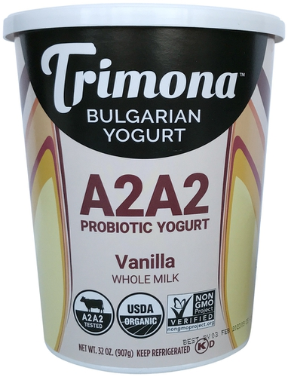
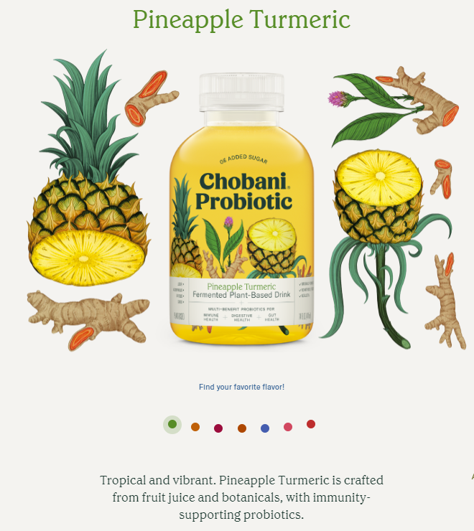
Yogurt for Immunity and Gut Health
Ingredients: Carbonated water, oat blend (water, whole grain oats), apple juice from concentrate (water, apple juice concentrate), pineapple juice from concentrate (water, pineapple juice concentrate), apple cider vinegar, natural flavors, turmeric juice, turmeric extract, cultures.
Trimona Bulgarian Yogurt A2A2 Probiotic Yogurt: Vanilla
United States, Jan 2023 | VIEW DETAILS
Claims: Probiotic. A2A2 tested. USDA organic. Non-GMO Project verified. Certified kosher dairy. Recyclable packaging. This Bulgarian yogurt will not only provide you with much needed vitamins, good fats, proteins and enzymes, but will also supply you with beneficial probiotics, excellent for your immune system and digestive tract. Grade A. Certified organic by PCO. Made with milk from grass-fed cows.
Notes:
Carbonated water: effective against gastrointestinal symptoms

Slide 29
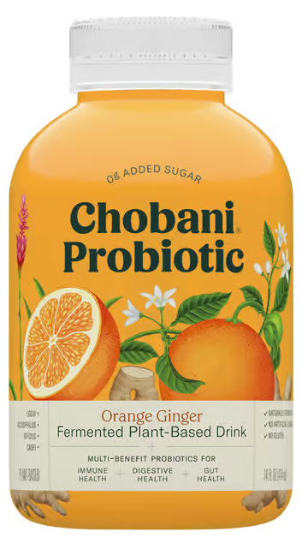
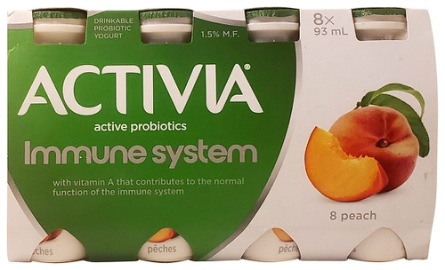
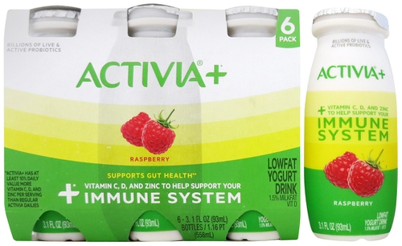
Immune + Gut Health claims
Activia Immune System Drinkable Probiotic Yogurt: Peach
Canada, Oct 2022 | VIEW DETAILS
Claims: With 1 billion active probiotics. 1.5% milk fat content. Vitamin A contributes to the normal function of the immune system. Source of vitamins A and B12. Probiotics contribute to healthy gut flora. Made with quality milk from the dairy farmers of Canada. Made with vitamins A and D fortified skimmed milk. Certified by Canadian Digestive Health Foundation. Sustainable Forestry Initiative certified. This box is made with 100% recycled fibers and is recyclable.
Chobani Probiotic Fermented Plant Based Drink: Orange Ginger
United States, Oct 2022 | VIEW DETAILS
Claims: Bright and citrusy. Crafted from fruit juice and botanicals, with immunity-supporting probiotics. Made with real fruit juice. Contains billions of probiotics. Gluten free. No artificial flavors or preservatives. Certified kosher dairy. Made with spice, tea extract, root and herbs. Probiotics help support immune and digestive health. Made from wholegrain oats. Plant-based. Naturally fermented. 0g added sugar. Multi-benefit probiotic for immune health, digestive health, and gut health.
Activia Plus Low Fat Yogurt Drink: Raspberry
United States, Sep 2022 | VIEW DETAILS
Claims: Low fat. Supports gut health. Added with vitamins C, D and zinc to support your immune system. Contains billions of live and active probiotics. Gluten free. Non GMO Project Verified. Grade A. Kosher. Contains 5% juice. Recyclable packaging.
Source: Innova Database

Slide 30
High growth for US Soft Drinks with Immune Health positioning
Puraqua Kiwi Melon Flavored
Probiotic Water
CLAIMS: 2 billion cultures. Naturally flavored. Promotes digestive and immune health. 6 essential vitamins. Contains 20 calories per bottle. Certified kosher. Recyclable packaging. Contains 0% juice.
INGREDIENTS: Water, cane sugar, citric acid, stevia rebaudiana leaf extract, natural flavor, probiotic culture (bacillus coagulans, gbi-30 6086), niacin (vitamin B3), d-calcium pantothenate (vitamin B5), d-alpha-tocopheryl acetate (vitamin E), fruit juice (color), pyridoxine hydrochloride (vitamin B6), vitamin A palmitate, turmeric extract (color), chromium picolinate, cyanocobalamin (vitamin B12). United States, Feb 2023
+ 28% CAGR
2018-2022

Slide 31
category insider
Key Findings

Slide 32
Key Findings
Some growth opportunities that we’ve looked at today:
Health claims: the intrinsic health benefits of yogurt are the key purchasing motivators for US consumers. Health claims not fully taken advantage of by dairy yogurt manufacturers:
Immune-related, where consumer interest is high: Immune health, digestive-gut health, prebiotic and probiotic claims to draw the consumers’ attention to the indisputable health benefits of yogurt.
Sugar reduction is also important to consumers: 20% of respondents told Innova that it is one of the claims (#3) that most influences their purchasing decision when selecting yogurt/drinkable yogurt.
The US yogurt category has primarily been focused on fat reduction, with half of all yogurts launched in the past year having a low/no/reduced fat claim.
Health-related flavor innovation: offering consumers flavor innovation that emphasizes for example the parallel they draw between certain flavor directions and immune health claims:
citrus flavors, berries, warm spices like turmeric .
Flavor is a key point-of-purchase motivator for consumers.
25% US yogurt consumers are influenced by real ingredients and “natural” claims.
Notes:
We won’t be in this downward facing economy for very long. Yog GREW during Covid. Can grow again
So where can yogurt potentially expand? Where is dairy yog going in the next 5 yrs? Where are the opportunities in the next 5 years?
Some growth opportunities that we’ve looked at today:
FLAVOR: WE’VE seen today how much Flavor influences purchasing behavior
SUGAR REDUCTION The US yogurt category has primarily been focused on fat reduction, with half of all yogurts launched in the past year having a low/no/reduced fat claim. However, US yogurt companies perhaps also need to start looking at sugar reduction, as has been the case in other markets around the world.

Slide 33
Facebook
Twitter
LinkedIn
RSS
WeChat
contact@innovami.com
www.innovamarketinsights.com
The information in this document is intended for informational and educational purposes only. Content including trademarks, brands and images are the property of their respective owners. Innova Market Insights is in no way liable for consequences associated with the contents of this document. Innova Market Insights may amend this document at any time without notice and no guarantees are offered in relation to any external links provided.

